Slide 1
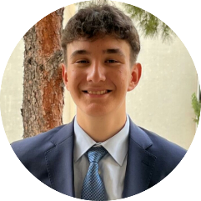
SERHAN YAMAN DURMUŞ
Computer Engineering Student
WORK EXPERİENCE
CONTACT
09.2026 - Now
Project Development Member
Burdur , TURKEY
Burdur, Turkey
+905348506748
- My team and I worked on projects at HSD Burdur Mehmet Akif Ersoy University. During this process, I both learned to work as a team and improved my skills in website development and cybersecurity.
serhanyamandurmus@gmail.com
serhanyamand
PERSONAL INFORMATİON
Nationality
Türkiye
Date of Birth
08.08.2008
Marital Status
Single
Driving License
-
LANGUAGES
EDUCATION
09.2026 – Now
Burdur Mehmet Akif Ersoy University
TR
TURKİSH
Burdur , TURKEY
Native
09.2022 – 06.2026
Bilnet Schools Karşıyaka Anatolian High School
EN
ENGLİSH
İzmir , TURKEY
Very Good
CERTİFİCATE
COMPUTER SKİLLS
09.2026
HSD Project Committee Membership Certificate
HTML
HUAWEİ Student Developers (HSD) Türkiye
10.2023
Hi-Kod Front-End Certificate
CSS
Kodluyoruz
CYBERSECURİTY
PYTHON

